Slide 1

Introduction to GitHub
Accessing, Sharing, and Storing Your Code and Notebooks
Wally Novak
CodeBMB Workshop

Slide 2
By the End of This Session You Will Be Able To...
Explain what GitHub is and why it is useful for scientists
Navigate a GitHub repository to find files and notebooks
Open a Colab notebook directly from GitHub
with or without an Open in Colab button
Fork a repository to create your own editable copy (GitHub account required)
Create a new repository from scratch
Describe how GitHub supports reproducibility, sharing, and collaboration in science

Slide 3
What Is GitHub and Why Do We Use It?
Think of GitHub as a combination of three things:
📁 Shared drive
📓 Lab notebook
🔗 Publishing platform
Store and access files from anywhere, on any device
Every change is recorded with who made it and when
Share your code with colleagues, students, or the world
Why GitHub specifically?
Free for public repositories
Used across science, industry, and education worldwide
Integrates directly with Google Colab with the Open in Colab button
Easily update materials (version control)

Slide 4
Key GitHub Vocabulary
Five terms you need to know before we start:
Repository (repo)
A folder that contains all the files for a project — code, notebooks, data, and documentation. This is effectively a project folder that lives in the cloud.
README
A text file (usually README.md) that appears on the front page of a repository. It explains what the project is and how to use it.
Commit
A saved snapshot of your files at a specific point in time, with a short message describing what changed.
Fork
Your own personal copy of someone else's repository. You can make changes to your fork without affecting the original.
Branch
A parallel version of the repository, the one you want is almost always called 'main.' You will rarely need to think about branches as a beginner.

Slide 5
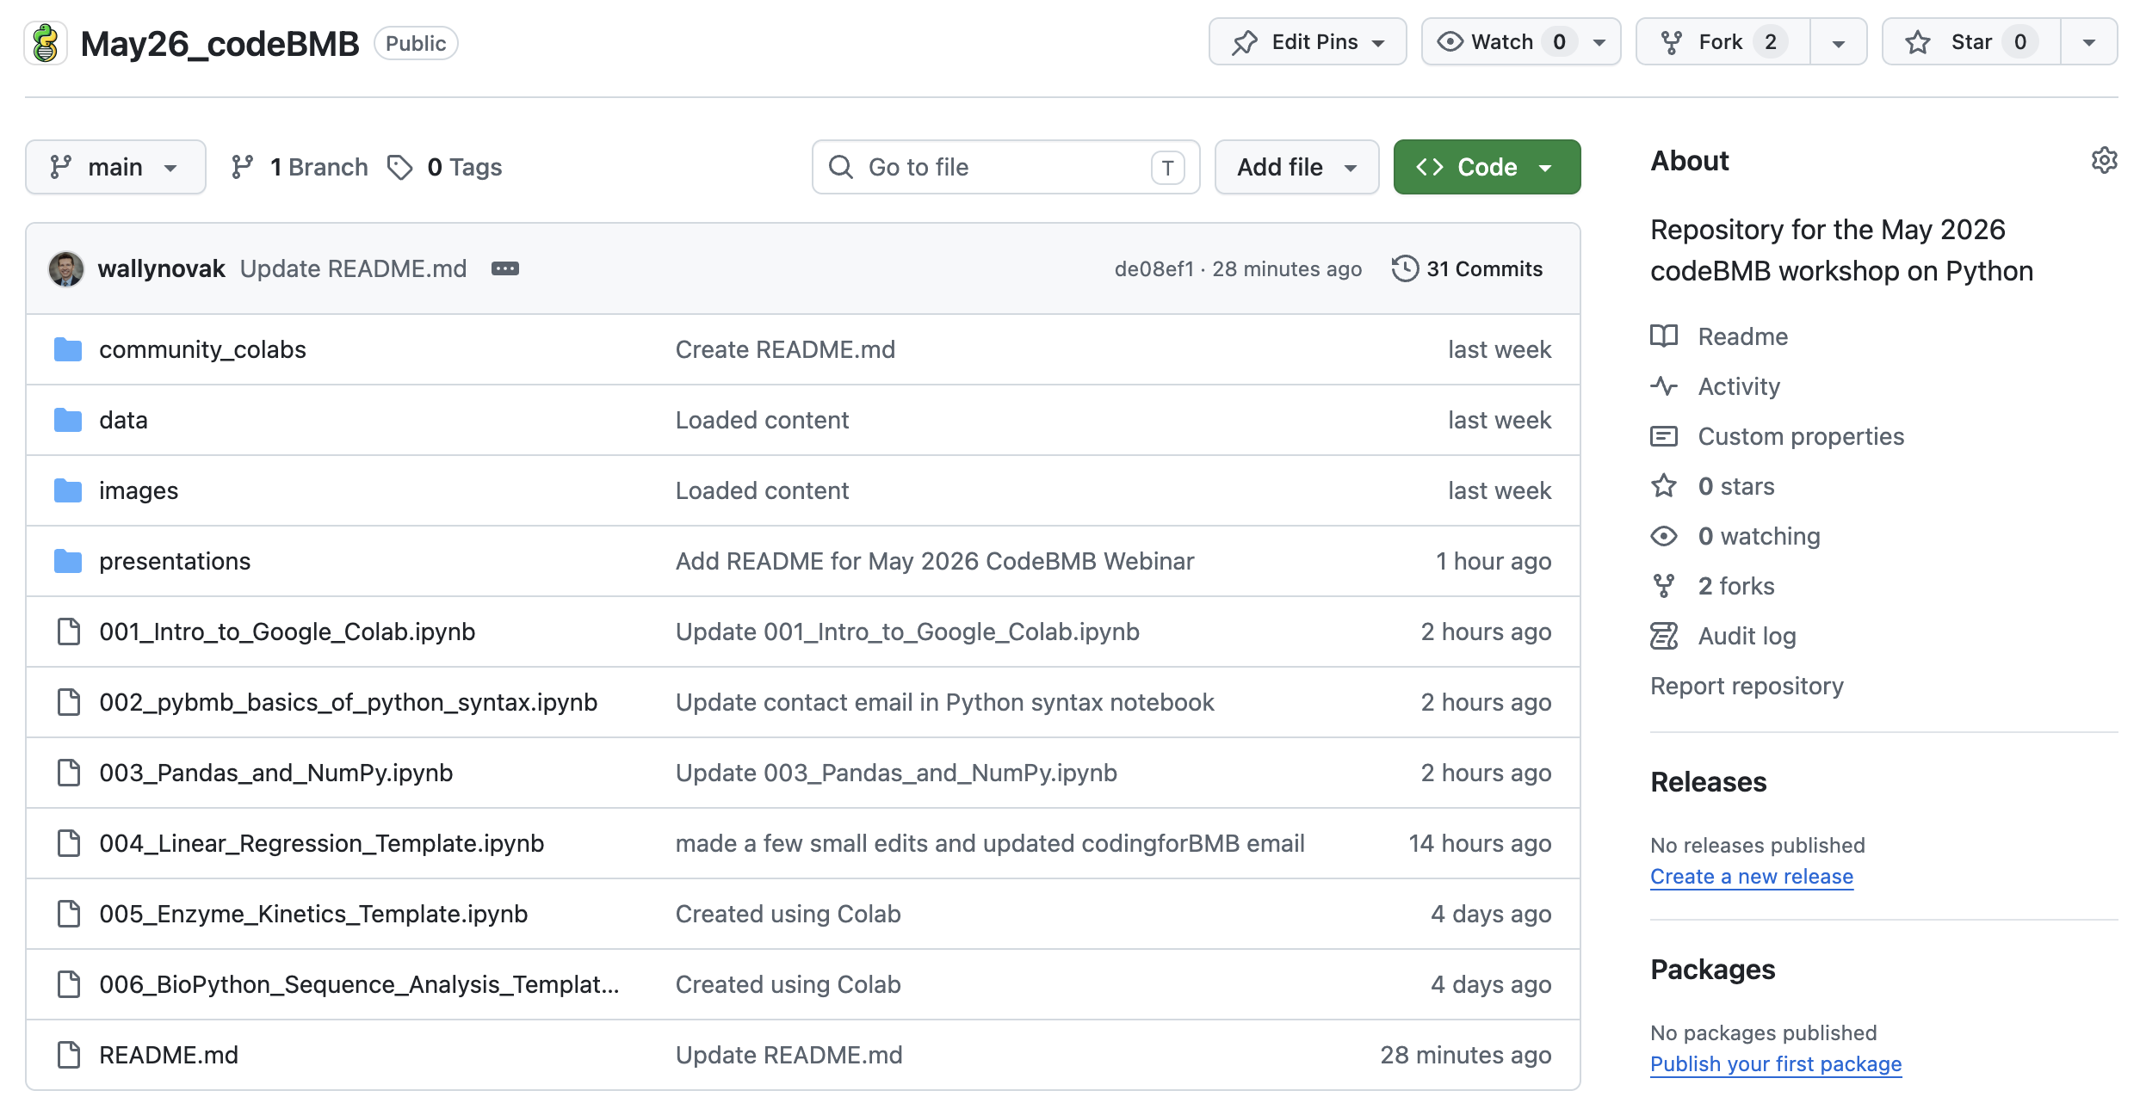
Anatomy of a GitHub Repository
① Repository name
② Folders
③ Notebooks
④ README

Slide 6
Walkthrough 1 — Finding the CodeBMB Repository
▶ WALKTHROUGH
Step 1
Open a browser and go to: github.com
Step 2
In the search bar at the top, type: codeBMB and press Enter
Step 3
Click on the repository: codeBMB/May26_codeBMB
Step 4
Read the README, this tells you what the repository contains
Step 5
Click on the file 001_Intro_to_Google_Colab.ipynb to see what a notebook looks like on GitHub
💡 Tip: You do not need a GitHub account to browse, read, or download files.

Slide 7
Walkthrough 2 — Opening a Notebook in Colab - A
▶ WALKTHROUGH
Option A — Using the Open in Colab button (easiest)
1
Navigate to the repository on GitHub
2
Find a notebook that has an "Open in Colab" button near the top of the README or file
3
Click the button — the notebook opens directly in Colab
4
Go to File → Save a copy in Drive to save your own editable version

Slide 8
Walkthrough 2 — Opening a Notebook in Colab - B
▶ WALKTHROUGH
Option B — No button? Use the GitHub tab in Colab
1
Go to colab.research.google.com
2
Click File → Open notebook
3
Click the GitHub tab
4
Paste the repository URL: github.com/codeBMB/May26_codeBMB
5
Select the notebook you want, and it opens immediately

Slide 9
Opening Any Notebook Without a Badge
The File → Open notebook → GitHub tab works for ANY public notebook on GitHub:
1
Go to colab.research.google.com
The URL you paste in step 5:
2
*Click "File" in the top menu
Format: github.com/username/REPO
Example: github.com/codeBMB/April26_Rutgers-RCSB
3
*Click "Open notebook"
4
Click the GitHub tab (you may see tabs for Google Drive, GitHub, and Upload)
5
Paste the repository URL and press Enter
6
Click the notebook you want from the list that appears
💡 This method works for any public GitHub notebook

Slide 10
Do You Need a GitHub Account?
Short answer: yes ☺ hopefully today!
❌ No account needed
✅ Account needed
✅ Browse any public repository
🔑 Fork a repository
✅ Read and view files
🔑 Save work back to GitHub
✅ Open a notebook in Colab via badge
🔑 Create your own repository
✅ Open a notebook via the GitHub tab
🔑 Share your notebooks publicly
✅ Download individual files
🔑 Contribute to the CodeBMB community
Creating a free GitHub account takes 2 minutes at github.com — you can do this before the next section if you haven't already.

Slide 11

Walkthrough 3 — Forking a Repository
▶ WALKTHROUGH
⚠️ This section requires a GitHub account. If you don't have one yet, follow along and try this at home.
A fork is your own personal copy of the CodeBMB repository. You can edit it, save to it, and build on it, all without changing the original!
1
Go to github.com/codeBMB/May26_codeBMB
2
Click the Fork button in the top-right corner of the repository page
3
Leave all settings as default and click Create fork
4
GitHub redirects you to YOUR copy of the repository at: github.com/YOUR-USERNAME/May26_codeBMB
N.B. Don’t use the Open in Colab button the first time you open your forked notebook. It still points to the codeBMB repo. Instead, use the method in walkthrough 2 to open your notebook and then save it to GitHub with the “Include a link to Colab” button checked. This updates the button to your repository!
5

Slide 12
Walkthrough 4 (Part 1) — Creating a New Repository
▶ WALKTHROUGH
⚠️ This section requires a GitHub account. If you don't have one yet, follow along and try this at home.
You can create a new repository for your own ideas. You can edit it, save to it, and build on it.
1
Go to github.com/YOUR-USERNAME
2
Click the + icon in the top-right corner of the page
3
Select New repository from the dropdown menu
4
Fill in the Repository name — use something descriptive like my-bmb-notebooks or bradford-assay
5
Set visibility — choose Public so anyone can access your notebooks via the Open in Colab badge
6
Check Add a README file — this creates the front page of your repository automatically, then click Create repository

Slide 13

Walkthrough 4 (Part 2) — Saving a New Colab Notebook
▶ WALKTHROUGH
⚠️ This section requires a GitHub account. If you don't have one yet, follow along and try this at home.
7
Create a notebook in Google Colab: Go to https://colab.research.google.com/ and click
8
Rename your notebook to something informative (e.g., “Linear_Regression.ipynb”) by clicking “Untitled1.ipynb” at the top left of the screen. Keep the .ipynb extension.
9
Go to File → Save a copy in GitHub
10
The first time you do this, GitHub will ask you to authorize Colab — click Authorize and sign in
11
In the dialog box that appears, select your repository from the dropdown
12
Confirm the branch is set to main and add a short commit message describing what you saved (e.g., "Add Bradford assay notebook")
13
Ensure Include a link to Colab is checked and click OK — your notebook is now saved to GitHub

Slide 14
Saving Your Work — Three Options
After working in a Colab notebook, you have three ways to save your work:
Option 1
Option 2
Option 3
Save to Google Drive
Save to GitHub
Download the file
File → Save a copy in Drive
File → Save a copy in GitHub
File → Download →
Download .ipynb
No GitHub account needed Saves to your Colab Notebooks folder Best for personal work and quick saves Recommended for beginners
GitHub account required Saves directly to your forked repository Creates a commit with a message Best for sharing and version control
No account needed Saves a local copy to your computer Can be re-uploaded to Colab later Best as a backup
✅ Best for most participants today
✅ Best for sharing with students
✅ Best as a backup

Slide 15
GitHub as a Scientific Tool
GitHub is not just for software engineers — it is increasingly the standard for open science:
📓
Every change is recorded with who made it and when. Full history of your analysis — reviewers and collaborators can see exactly what you did and when.
🔗
Post a repository for a course — students fork it, work in their own copy, and submit via GitHub or Google Drive. No emailing notebooks back and forth.
Lab notebook for code
Sharing with students
🌍
Publish your analysis code alongside your paper. Readers can reproduce your results exactly. Journals increasingly require this.
🤝
The PyBMB community shares notebooks on GitHub. Fork a notebook, improve it, and share it back. Living documents that stay current.
Open science
Community and collaboration

Slide 16
What You Can Do Now
✅ Navigate any public GitHub repository
✅ Open any notebook in Colab — with or without an Open in Colab button
✅ Fork the May26_codeBMB repository
✅ Create your own repository and save a new Colab notebook to it
✅ Save your work to Google Drive or back to GitHub
Workshop repository: github.com/codeBMB/May26_codeBMB Create a free GitHub account at: github.com

Slide 18
Pro tip — Build Your Own Open in Colab Badge
Once you have your own GitHub repository, you can add an "Open in Colab" button to any notebook.
[![Open In Colab]
(https://colab.research.google.com/assets/colab-badge.svg)]
(https://colab.research.google.com/github/USERNAME/REPO/blob/BRANCH/NOTEBOOK.ipynb)
What to replace:
USERNAME
Your GitHub username
e.g.: codeBMB
REPO
Your repository name
e.g.: April26_Rutgers-RCSB
BRANCH
Almost always: main
e.g.: main
NOTEBOOK.ipynb
Exact filename including path if in a folder
e.g.: 001_Intro_to_Google_Colab.ipynb
💡 Shortcut: copy the URL of your notebook from the browser bar and replace github.com with colab.research.google.com/github
N.B. Must be all on one line in the notebook.

